Slide 1
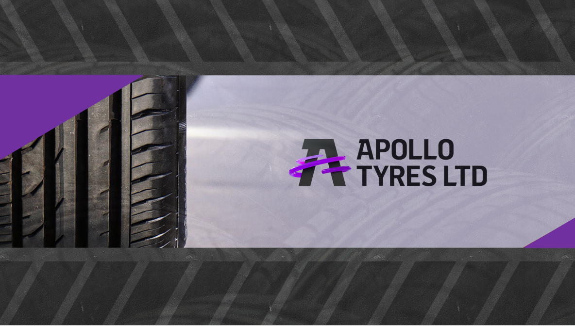

Slide 2


Overview
Vision & values
Brand Analysis
Competitors
MRF Tyres
JK Tyres
Customer analysis
Performance
Sales

Slide 3

Vision & Values
Vision
Driving Progress, Together
Revenue Goal
$5Bn
(FY26)
Purpose
Enabling Excellence
Values
Following our Passion
One Family
Taking Responsibility

Slide 4
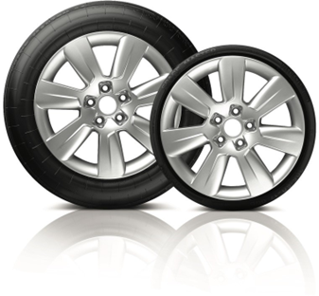
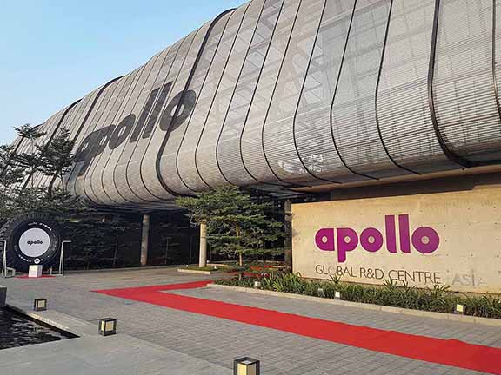
Brand Analysis
Brand Image and Reputation
Apollo Tyres has built a strong brand image and reputation in the tire industry. They are known for providing reliable and safe tire solutions.
The company's sponsorship of various sports events, including cricket, has helped boost its brand visibility.
Environmental Responsibility
Apollo Tyres is increasingly focusing on sustainability and environmental responsibility. They have initiatives aimed at reducing their carbon footprint and promoting eco-friendly practices in tire manufacturing.

Slide 5
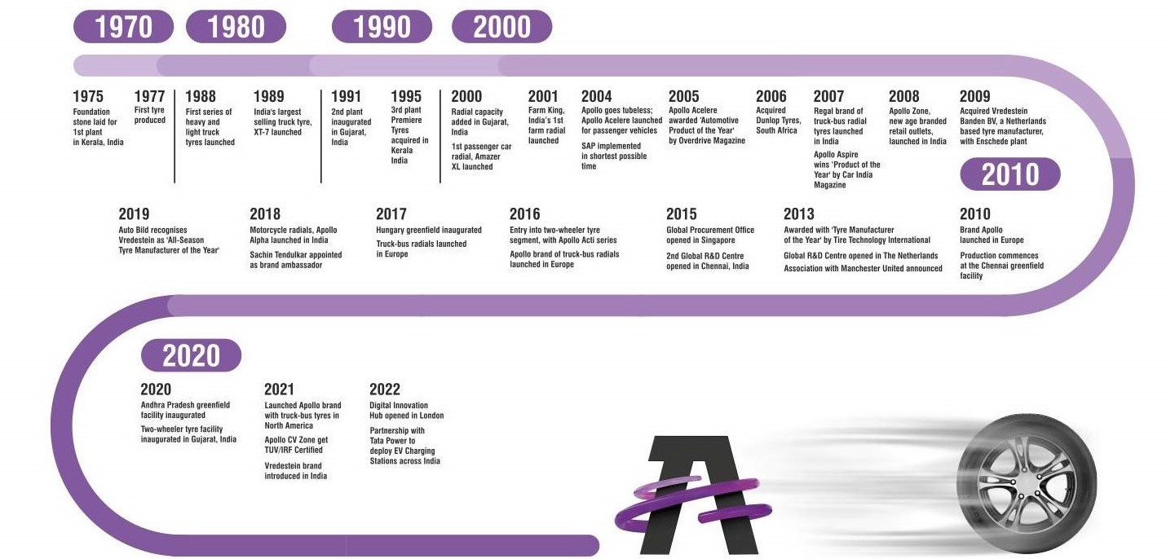
Our Journey So Far….
Our growth has been driven by a well thought out strategy of organic and inorganic initiatives.

Slide 6

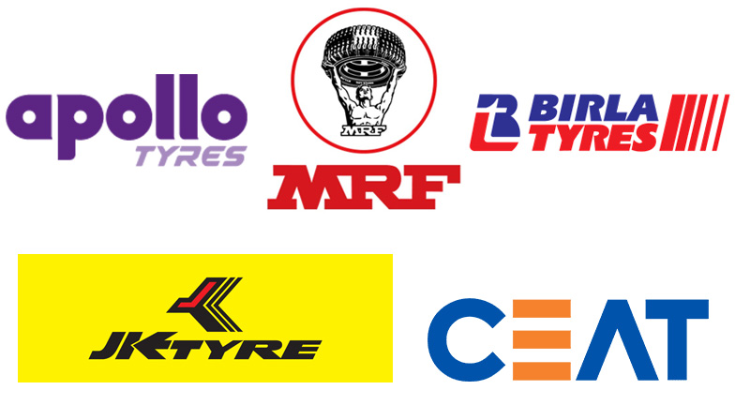
Competitors

Slide 7

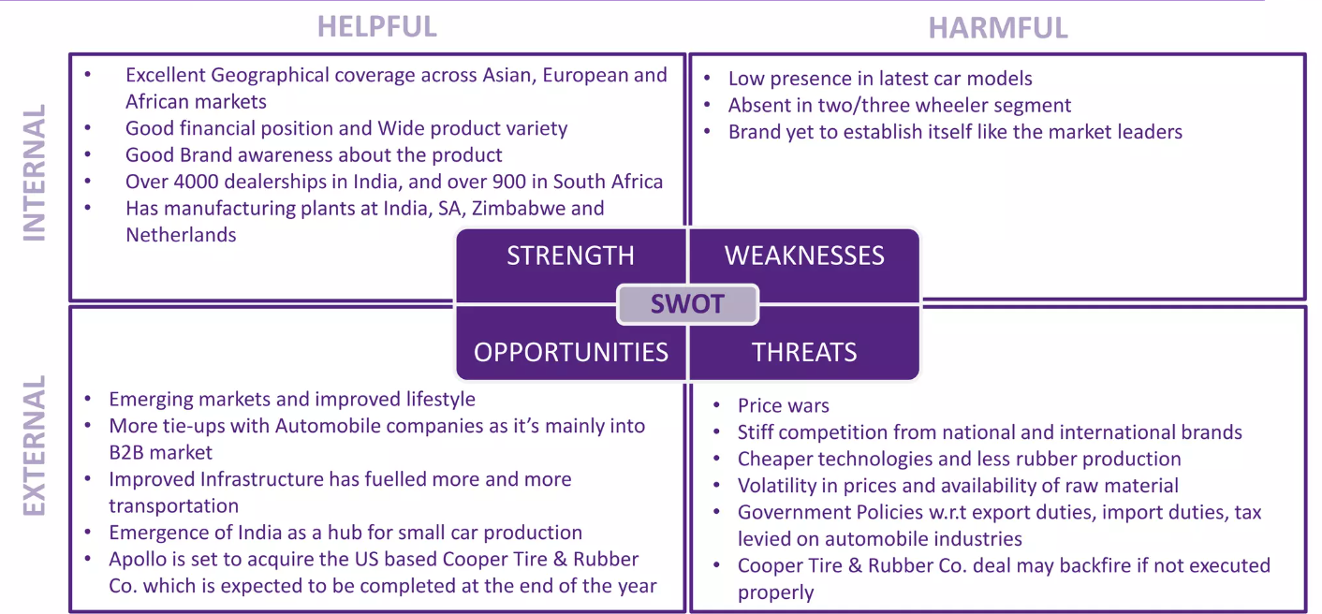

Slide 8


S
Strong brand equity and consumer loyalty
W
Volatility in industrial relations
O
Emerging markets and growth of automobile industry
T
Price wars
Strong position on the financial side
Advertising as an eco-friendly car tyre-making business in India.
Company has remained No.1 in Tyre Industry in India.
More links with automotive companies
Intense competition thanks to presence of other global brands
Horizontal and concentric diversification
Cheaper technologies
Government Policies w.r.t export duties, import duties
Stiff competition from national and international brands

Slide 9

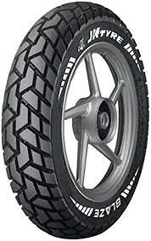
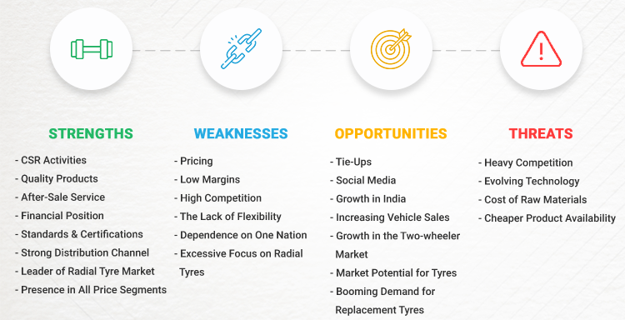

Slide 10
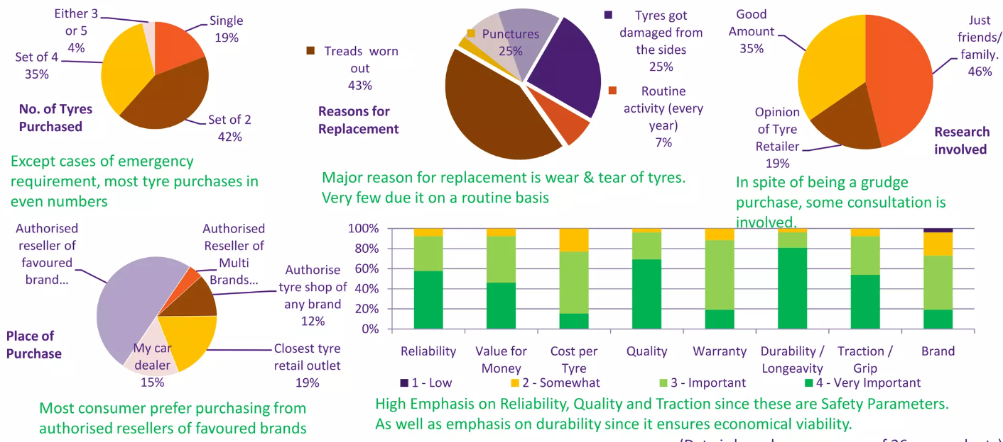
Customer Behaviour

Slide 11
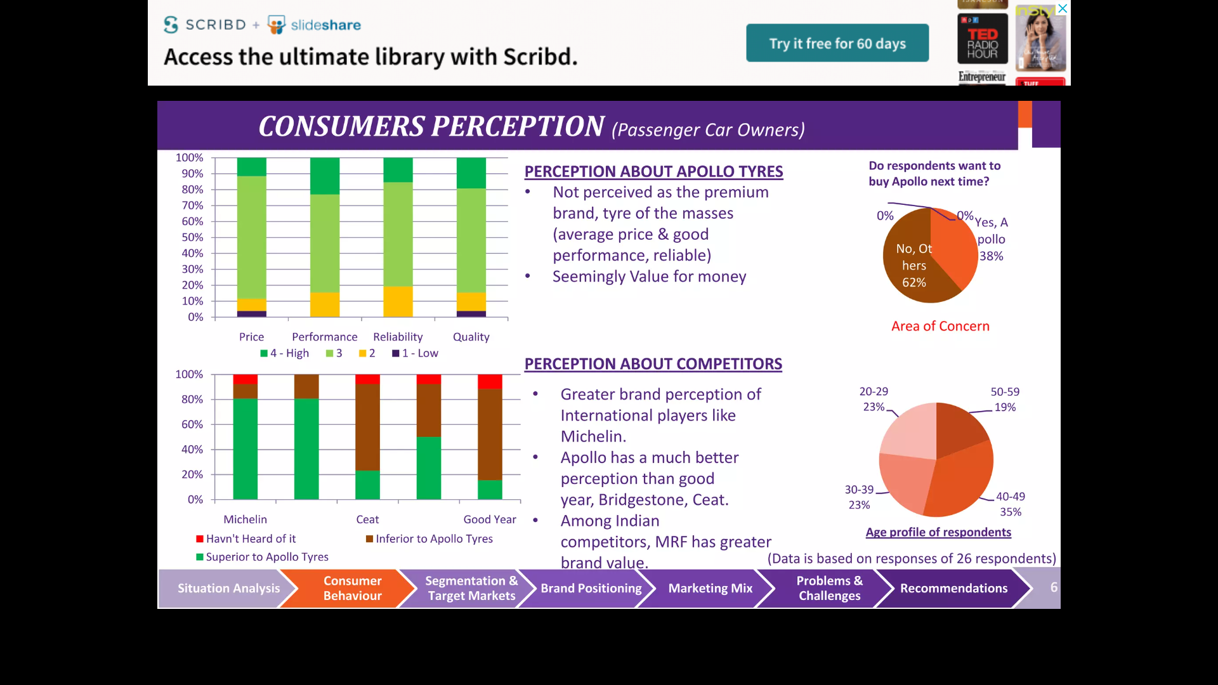
Customer Behaviour

Slide 12




Key Performance Indicators
Revenue Segmentation (Indian Rupees)
22.6
3.8
6.0
5.0
36.6
9.6
Geography (%)
Customers (%)
Products (%)
28.4
77.4
67.7
Passenger Vehicles Truck-Bus
Off Highway
Light Truck
Other
APMEA
Europe Others
Replacement OEM
43
Revenue from Operations (₹ Bn)
Net Profit (₹ Bn)
Capital Expenditure Outflow (₹ Bn)
175.49
6.80
FY19
22.93
FY19
FY19
FY19
163.50
4.76
28.36
FY20
FY20
FY20
FY20
173.97
3.50
11.90
FY21
FY21
FY21
209.48
6.39
18.46
FY22
FY22
FY22
245.68
11.05
7.75
FY23
FY23
FY23

Slide 13
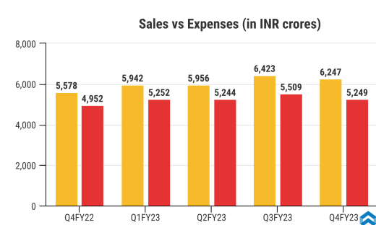

Slide 14







Sustainability
Achieving
across the entire value chain
6 Pillars FY26
1
Sustainability Governance
2
Climate Adaptation
3
Circular Economy
4
Value Chain
5
People
6
Community CSR
Sustainability is one of our key Pillars of vision FY26

Slide 15
Content Creation
Instagram Page Link
https://www.instagram.com/apollotyresltd/?hl=en
Instagram Story Link
https://www.instagram.com/s/aGlnaGxpZ2h0OjE3OTU3NTAzMzMxMjkwODYx?story_media_id=3061130741355608321_2915679571&igshid=MzRlODBiNWFlZA==

Slide 16
Instagram Story
Instagram Page Link
https://www.instagram.com/apollotyresltd/?hl=en
Instagram Post Link
https://www.instagram.com/p/CyLV3ymN4MA/?igshid=MzRlODBiNWFlZA==

Slide 17

Team Roles and Contribution
G. Lavanya ( Team Lead )
Brand Research , Competitors Analysis
M. Siva Prasanth
Competitors and Customer Analysis
D. Navyasri
Content idea Generation & Strategy
K. Venkata Satwik
Performances and Sales

Slide 18

Thank You

